Slide 1

Classification

Slide 2







What is Classification ?
Supervised
Classification
Regression
Human Supervision?
Unsupervised
Reinforcement
Machine Learning
Learn Incrementally?
How they generalize?
Machine Learning

Slide 3
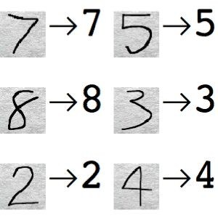



What is Classification ?
Identifying to which label something belongs to
5
Not 5

Slide 4
What is Classification ?
Classification is the task of
Identifying to which category a new observation belongs
On the basis of observations whose category is known

Slide 5
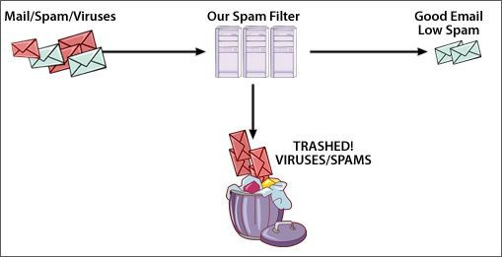
Examples of Classification
Classifying emails as spam or not spam

Slide 6
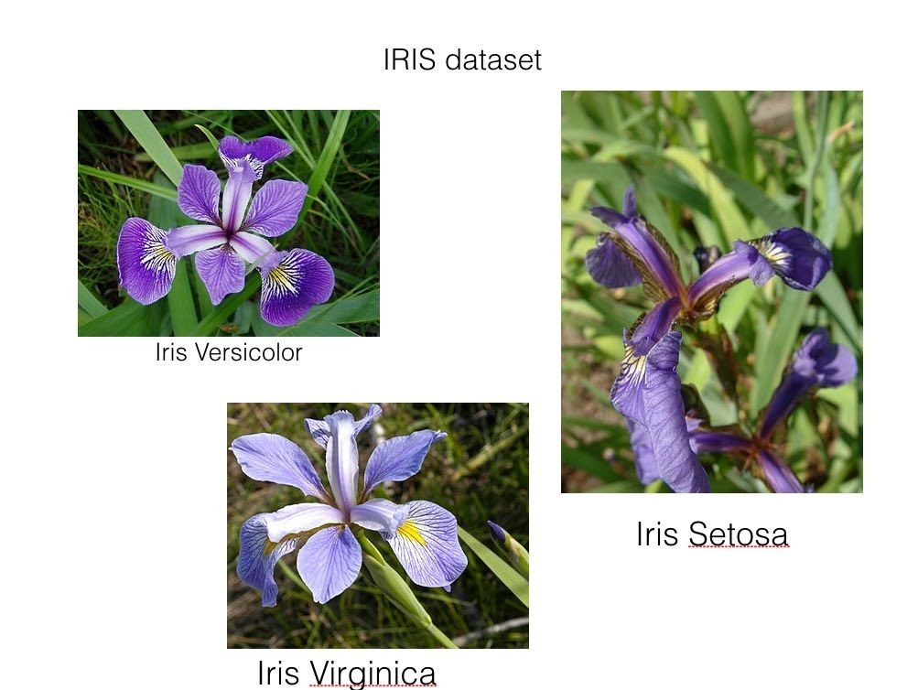
Examples of Classification
Classifying flowers of a particular species like the Iris Dataset

Slide 7

Examples of Classification
Classifying a credit card transaction as fraudulent or genuine

Slide 8
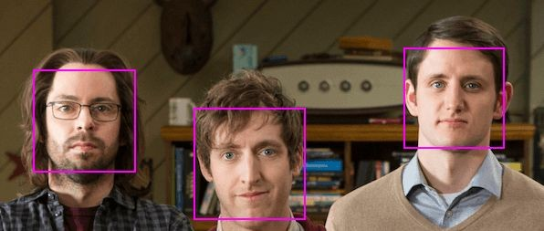
Examples of Classification
Face recognition

Slide 9
Goal - Project
The goal of this session is to classify handwritten digits

Slide 10
Binary and Multiclass Classification
Binary Classification
Multiclass Classification
5
Not 5
Classification is done between two classes
Classification is done between multiple classes

Slide 11
Dataset
MNIST Dataset
Modified National Institute of Standards and Technology
In this problem, we will use MNIST dataset
Set of 70, 000 small images of
Digits handwritten by high school students and
Employees of the US Census Bureau

Slide 12
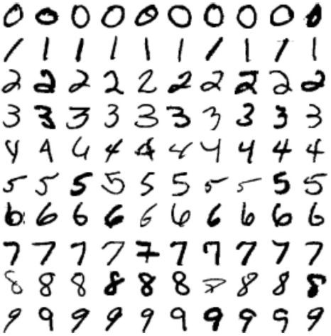
Dataset
MNIST Dataset
Each image is labeled with the digit it represents
Few Digits from the MNIST Dataset

Slide 13
Dataset
MNIST Dataset
MNIST dataset is also called
“Hello World” of Machine Learning
Whenever people come up with new algorithm
They test it on MNIST dataset to see how it performs

Slide 14
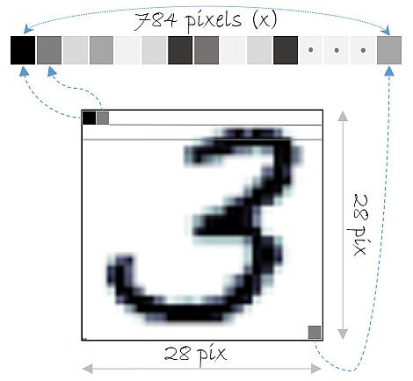
Dataset
Each image
28 X 28 pixels
784 features
There are 70000 such images making the dataset dimension:
70000 X 784

Slide 15

Fetching MNIST dataset in Scikit-Learn
Fetch the Data
>>> from sklearn.datasets import fetch_openml
>>> mnist = fetch_openml('mnist_784', version=1, cache=True)
>>> X, y = mnist["data"], mnist["target"]
Switch to Notebook

Slide 16

Switch to Notebook

Slide 17
Fetching MNIST dataset in Scikit-Learn
Looking at one of the data samples
>>> %matplotlib inline
>>> import matplotlib
>>> import matplotlib.pyplot as plt
>>> some_digit = X[36000] # Selecting the 36,000th image.
>>> some_digit_image = some_digit.reshape(28, 28)
>>> plt.imshow(some_digit_image, cmap = matplotlib.cm.binary, interpolation="nearest")
>>> plt.axis("off")
>>> plt.show()
Switch to Notebook

Slide 18
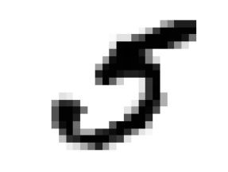
Fetching MNIST dataset in Scikit-Learn
Looking at one of the data samples
Switch to Notebook

Slide 19


Steps
Divide dataset into training and test samples
Train the classifier using training dataset
Test using test dataset
Performance metrics (Finalize the model)
Improve the model using error analysis

Slide 20
Training and Test dataset
We split the data into
Training set - Contains 60,000 out of 70,000 samples
Test set - Contains 10,000 out of 70,000 samples
We train the model on training set
And evaluate the performance of the model on test set

Slide 21


Training and Test dataset
Training Dataset (60, 000 images) - shuffling is important
Entire dataset (70, 000 images)
Test Dataset (10, 000 images)

Slide 22
Dividing dataset into training and test samples
Dividing dataset into training and test in python:
>>> X_train, X_test, y_train, y_test = X[:60000], X[60000:], y[:60000], y[60000:]
>>> import numpy as np
>>> np.random.seed(42)
>>> shuffle_index = np.random.permutation(60000)
>>> X_train, y_train = X_train[shuffle_index], y_train[shuffle_index]
Switch to Notebook

Slide 23
Switch to Notebook

Slide 24
Steps
Divide dataset into training and test samples
Train the classifier using training dataset
Test using test dataset
Performance metrics (Finalize the model)
Improve the model using error analysis

Slide 25
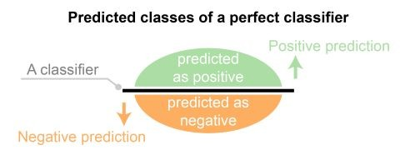
Binary Classifier
What is a Binary Classification?
Binary or binomial classification is the task of classifying the elements of a given set into two groups (predicting which group each one belongs to) on the basis of a classification rule.

Slide 26
Binary Classifier
What is a Binary Classification?
Binary or binomial classification is the task of classifying the elements of a given set into two groups (predicting which group each one belongs to) on the basis of a classification rule.
5
Example:
Not 5
Output: Classification
Input: Image

Slide 27
Stochastic Gradient Descent (SGD) Classifier
We are going to use: Stochastic Gradient Descent (SGD) Classifier

Slide 28
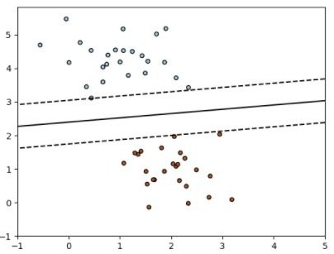
Stochastic Gradient Descent (SGD) Classifier
For the two-dimensional (2 features) training dataset,
Trying to estimate the coefficients of the line which can be
Best-fitted dividing the two categories
Class: 1
SGD
Classifier
Class: 0

Slide 29
Stochastic Gradient Descent (SGD) Classifier
The classifier SGDClassifier implements
a plain stochastic gradient descent learning routine
supports different loss functions and
penalties for classification
Class: 1
SGD
Classifier
Class: 0

Slide 30
Training a Binary Classifier using SGD
Stochastic Gradient Descent (SGD) Classifier
Capable of handling large datasets
Deals with training instances independently
Well suited for online training

Slide 31

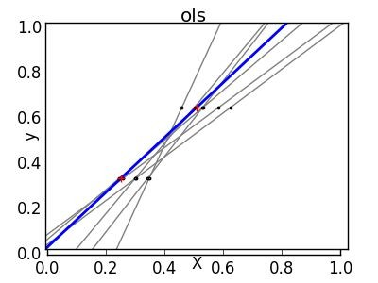

Machine Learning - Gradient Descent
Instead of trying all lines, go into the direction yielding better results
Machine Learning

Slide 32

Machine Learning - Gradient Descent
Imagine yourself blindfolded on the mountainous terrain
And you have to find the best lowest point
If your last step went higher, you
will go in opposite direction
Other, you will keep going just faster
Machine Learning

Slide 33
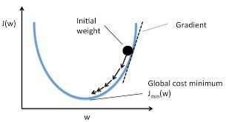
Machine Learning - Gradient Descent
Machine Learning

Slide 34
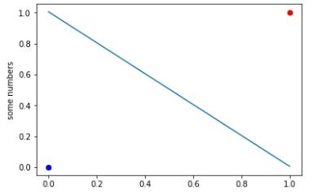
Stochastic Gradient Descent (SGD) Classifier
Example:
Let Us try with a simple problem
Train the SGD Classifier dataset on two points (0,0) and (1,1)
Plot the classifier along with the training dataset
Check the classifier with a test dataset (2,2)
(1,1) Class: 1
(0,0) Class: 0

Slide 35
Stochastic Gradient Descent (SGD) Classifier
Forming the dataset and training the classifier
{"xcoord":pd.Series([0,1]),"ycoord":pd.Series([0,1])}
>>> | from | sklearn.linear_model | import | SGDClassifier
>>> | X1 =
>>> | X3 = | pd.DataFrame(X1)
>>> | y = | [0, 1]
>>> | clf | = SGDClassifier(loss="hinge", | penalty="l2")
clf.fit(X3, y)
Loss function: hinge for linear classifier
Penalties: L2 = least squares for distance calculation

Slide 36
Stochastic Gradient Descent (SGD) Classifier
What is hinge loss?
A way to measure how badly a classifier is doing
We need to minimize this particular variable
Hinge loss is particularly used for linear classifiers

Slide 37
Stochastic Gradient Descent (SGD) Classifier
Example code of using SGD Classifier
Result of the fitted classifier - the coefficients and intercept
>>> print(clf.coef_)
>>> print(clf.intercept_[0]) [[ 9.91080278 9.91080278]]
-9.97004991017

Slide 38
Stochastic Gradient Descent (SGD) Classifier
Plotting the dataset and the classifier for illustration
>>> import matplotlib.pyplot as plt
>>> plt.plot(X3[0:1],'bo')
>>> plt.plot(X3[1:],'ro')
>>> a=np.linspace(0.,1.,num=11)
>>>
b=(-a*clf.coef_[0,0]-clf.intercept_[0])/clf.coef_[0,1]
>>> plt.plot(a,b)
>>> plt.show()
(1,1) Class: 1
(0,0) Class: 0

Slide 39
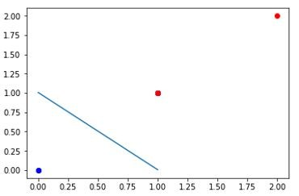
Stochastic Gradient Descent (SGD) Classifier
Testing the classifier with a test data point (2,2)
- Classifier correctly identifies it to belong to class 1
>>> print(clf.predict([[2., 2.]]))
[1]
(2,2) Class: 1 (prediction)
(1,1) Class: 1
(0,0) Class: 0

Slide 40
Switch to Notebook

Slide 41
Training SGD Classifier in Scikit Learn
Original problem: ‘5’ and ‘Not 5’ classifier
>>> from sklearn.linear_model import SGDClassifier
>>> sgd_clf = SGDClassifier(random_state=42, max_iter=10)
>>> sgd_clf.fit(X_train, y_train_5)

Slide 42
Switch to Notebook

Slide 43


Steps
Divide dataset into training and test samples
Train the classifier using training dataset
Test using sample data
Performance metrics (Finalize the model)
Improve the model using error analysis

Slide 44
Testing SGD Classifier in Scikit Learn
36000th image stores the digit 5 and the classifier correctly classifier it as ‘True’
>>> some_digit = X[36000] # Taking the 36,000th image
>>> sgd_clf.predict([some_digit])
array([True], dtype=bool)

Slide 45
Switch to Notebook

Slide 46
Steps
Divide dataset into training and test samples
Train the classifier using training dataset
Test using sample data
Performance metrics (Finalize the model)
Improve the model using error analysis

Slide 47
Performance measure - Methods
Cross Validation - Accuracy
Confusion Matrix
Precision
Recall
F1 score
ROC Curve

Slide 48
Steps
Divide dataset into training and test samples
Train the classifier using training dataset
Test using sample data
Performance metrics (Finalize the model)
Improve the model using error
analysis
Cross
Validation - Accuracy
Confusion Matrix
Precision
Recall
F1 Score
ROC Curve

Slide 49
Performance measure - Cross Validation
What is cross-validation?
It involves splitting the training set into K distinct subsets called folds,
Trains and evaluates the model K times, picking a different fold for evaluation every time and training on the other K-1 folds.
The result is an array containing K evaluation scores.
There can be different evaluation methods like accuracy, average_precision, etc.

Slide 50
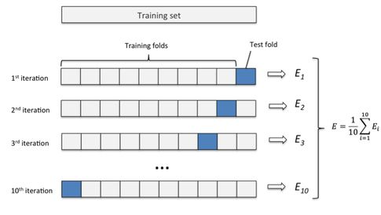
Performance measure - Cross Validation
Here k = 10

Slide 51
Performance measures - Cross Validation
cross_val_score
As discussed in end-to-end project session, cross_val_score() function in scikit-learn can be used to perform cross validation

Slide 52





Performing Cross validation in Scikit learn
Initiating cross validation method
>>> from sklearn.model_selection import cross_val_score
>>> cross_val_score(sgd_clf, X_train, y_train_5, cv=3, scoring="accuracy")
Scoring parameter
Classifier object
Training data
Labels
No. of folds
(Here, scoring parameter is accuracy)
Switch to Notebook

Slide 53
Performing Cross validation in Scikit learn
Initiating cross validation method
>>> from sklearn.model_selection import cross_val_score
>>> cross_val_score(sgd_clf, X_train, y_train_5, cv=3, scoring="accuracy")
Scoring parameter
Classifier object
Training data
Labels
No. of folds
array([ 0.9486, 0.9654, 0.957 ])
- The resulting accuracy is above 95 % for each of the folds

Slide 54
Performing Cross validation in Scikit learn
array([ 0.9486, 0.9654, 0.957 ])
- The resulting accuracy is above 95 % for each of the folds
The resulting accuracy of 95% is good enough?
Accuracy may not be a good performance measure when dealing with skewed datasets
Ours is a skewed dataset with only 10% of the data as digit 5.

Slide 55
Performing Cross validation in Scikit learn
Is the accuracy of 95% good enough?
Let us see another Classifier: Never5Classifier
>>> from sklearn.base import BaseEstimator
>>> class Never5Classifier(BaseEstimator): def fit(self, X, y=None):
pass
def predict(self, X):
return np.zeros((len(X), 1), dtype=bool)
Switch to Notebook

Slide 56
Performing Cross validation in Scikit learn
Is the accuracy of 95% good enough?
Let us see another Classifier: Never5Classifier
- What shall be the accuracy of Never5Classifier?
>>> from sklearn.base import BaseEstimator
>>> class Never5Classifier(BaseEstimator): def fit(self, X, y=None):
pass
def predict(self, X):
return np.zeros((len(X), 1), dtype=bool)
Switch to Notebook

Slide 57
Performing Cross validation in Scikit learn
Is the accuracy of 95% good enough?
Let us see another Classifier: Never5Classifier
- What shall be the accuracy of Never5Classifier? 90%
Calculating accuracy using cross_val_score
>>> never_5_clf = Never5Classifier()
>>> cross_val_score(never_5_clf, X_train, y_train_5, cv=3, scoring="accuracy")
Switch to Notebook

Slide 58
Performing Cross validation in Scikit learn
Is the accuracy of 95% for SGD Classifier good enough? Probably Not!
Never5Classifier - a dumb classifier gave an accuracy of 90%
We need a better measure of performance for the classifier

Slide 59
Steps
Divide dataset into training and test samples
Train the classifier using training dataset
Test using sample data - some_digit
Performance metrics (Finalize the model)
Improve the model using error
analysis
Cross
Validation - Accuracy
Confusion Matrix
Precision
Recall
F1 Score
ROC Curve

Slide 60
Performance measures - Confusion Matrix
What is confusion matrix?
The general idea is to count the number of times instances of class A are classified as class B.
Can be better than simple accuracy

Slide 61
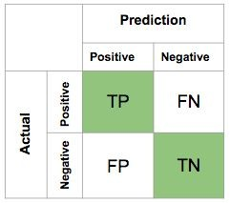
Performance measures - Confusion Matrix
True Positive (TP)
False Negative (FN)
TN = True Negative TP = True Positive FN = False Negative FP = False Positive
False Positive (FP)
True Negative (TN)

Slide 62
Confusion Matrix - Example
For ‘5’ and ‘Not 5’ classifier
The first row of this matrix considers non-5 images (the negative class):
53,272 of them were correctly classified as non-5s (they are called true negatives)
The remaining 1,307 were wrongly classified as 5s (false positives).
True Negative (TN)
False Positive (FP)
Confusion Matrix
Prediction
Not 5
5
Total
Not 5
53272
1307
54579
Actual
5
1077
4344
5421
False Negative (FN)
True Positive (TP)
Total
54349
5651
60000

Slide 63
Confusion Matrix - Example
For ‘5’ and ‘Not 5’ classifier
The second row considers the images of 5s (the positive class):
1,077 were wrongly classified as non-5s (false negatives)
The remaining 4,344 were correctly classified as 5s (true positives).
True Negative (TN)
False Positive (FP)
Confusion Matrix
Prediction
Not 5
5
Total
Not 5
53272
1307
54579
Actual
5
1077
4344
5421
False Negative (FN)
True Positive (TP)
Total
54349
5651
60000

Slide 64
Performance measures - Confusion Matrix
Confusion matrix in Scikit Learn
first need to have a set of predictions,
Then, they can be compared to the actual targets.
>>> from sklearn.model_selection import cross_val_predict
>>> y_train_pred = cross_val_predict(sgd_clf, X_train, y_train_5, cv=3)

Slide 65


Performance measures - Confusion Matrix
Confusion matrix in Scikit Learn
Then we compare the predicted value and the actual values
>>> from sklearn.metrics import confusion_matrix
>>> confusion_matrix(y_train_5, y_train_pred)
Actual Labels of the training samples
Classifier cross validation prediction results

Slide 66
Performance measures - Confusion Matrix
Confusion matrix in Scikit Learn
>>> from sklearn.model_selection import cross_val_predict
>>> y_train_pred = cross_val_predict(sgd_clf, X_train, y_train_5, cv=3)
>>> from sklearn.metrics import confusion_matrix
>>> confusion_matrix(y_train_5, y_train_pred)
array([[53606,
[ 1607,
973],
3814]])
Run it on Notebook

Slide 67
Performance measures - Confusion Matrix
Confusion matrix in Scikit Learn
array([[53606,
[ 1607,
973],
3814]])
The first row of this matrix considers non-5 images (the negative class):
+ 53,606 of them were correctly classified as non-5s (they are called true negatives)
+ The remaining 973 were wrongly classified as 5s (false positives).
Run it on Notebook

Slide 68
Performance measures - Confusion Matrix
Confusion matrix in Scikit Learn
array([[53606,
[ 1607,
973],
3814]])
The second row considers the images of 5s (the positive class):
+ 1,607 were wrongly classified as non-5s (false negatives)
+ The remaining 3,814 were correctly classified as 5s (true positives).
Run it on Notebook

Slide 69
Steps
Divide dataset into training and test samples
Train the classifier using training dataset
Test using sample data - some_digit
Performance metrics (Finalize the model)
Improve the model using error
analysis
Cross
Validation - Accuracy
Confusion Matrix
Precision
Recall
F1 Score
ROC Curve

Slide 70
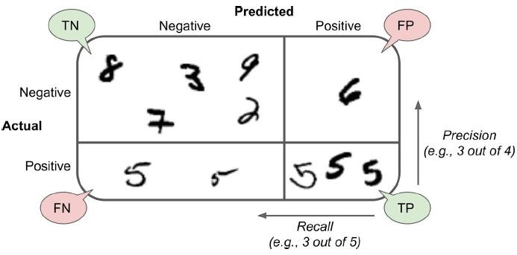
Performance measures - Precision and recall
‘5’ and ‘Not 5’ classifier

Slide 71

Performance measures - Precision and recall
True - Positive means the classifier correctly classified the Positive class.
False - Positive means the classifier incorrectly classified a Negative
class as Positive Class.

Slide 72

Performance measures - Precision and recall
True - Positive means the classifier correctly classified the Positive class.
False - Negative means the classifier incorrectly classified a Positive
class as Negative Class.

Slide 73
Performance measures - Precision and recall
‘5’ and ‘Not 5’ classifier
True Negative (TN)
False Positive (FP)
Prediction
Not 5
5
Total
Recall
Not 5
53272
1307
54579
Actual
5
1077
4344
5421
= 4344 / 5421
Total
54349
5651
60000
Precision
= 4344/5651
= 76.87 %
False Negative (FN)
True Positive (TP)

Slide 74
Performance measures - Precision and recall
Precision and recall in Scikit-Learn
For 5 and Not 5 Classifier
>>> from sklearn.metrics import precision_score, recall_score
>>> precision_score(y_train_5, y_pred) 0.796741174013
>>> recall_score(y_train_5, y_train_pred) 0.70356022874

Slide 75
Switch to Notebook

Slide 76
Steps
Divide dataset into training and test samples
Train the classifier using training dataset
Test using sample data - some_digit
Performance metrics (Finalize the model)
Improve the model using error
analysis
Cross
Validation - Accuracy
Confusion Matrix
Precision
Recall
F1 Score
ROC Curve

Slide 77

Performance measures - F1 score
F1 score = is a measure of how close recall and precision are to each other.

Slide 78
Performance measures - F1 score
F1 score for ‘5’ and ‘Not 5’ classifier
Prediction
Not 5
5
Total
Recall
Not 5
53272
1307
54579
Actual
5
1077
4344
5421
= 4344 / 5421
Total
54349
5651
60000
Precision
= 4344/5651
= 76.87 %
F1 score = 0.78468

Slide 79
Performance measures - F1 score
F1 score using Scikit-Learn
For 5 and Not 5 Classifier
>>> from sklearn.metrics import f1_score
>>> f1_score(y_train_5, y_train_pred) 0.74725705329153613

Slide 80
Switch to Notebook

Slide 81
Steps
Divide dataset into training and test samples
Train the classifier using training dataset
Test using sample data - some_digit
Performance metrics (Finalize the model)
Improve the model using error
analysis
Cross
Validation - Accuracy
Confusion Matrix
Precision
Recall
F1 Score
ROC Curve
TRADE-OFF

Slide 82
Performance measures - Precision vs Recall
Different use cases may require different precision and recall
Performance measure | Detect videos that are unsafe for kids | Detect shoplifters in surveillance images
Precision | High | Low
Recall | Low | High
 | FP should be low, FN can be high | FP can be high, FN should be low
Increasing precision reduces recall, and vice versa.
Raising the threshold decreases Recall and increases Precision

Slide 83

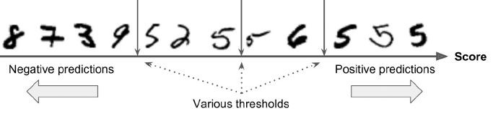
Precision / Recall Tradeoff - Thresholds
How does SGDClassifier work?
Classification is done on the basis of a score as calculated by the decision function in SGD Classifier
Score above a certain threshold is classified as positive class
Score below a certain threshold is classified as negative class

Slide 84
Precision / Recall Tradeoff - Thresholds
Thresholds can be set to achieve certain precision and recall as required.
Let us observe the above example

Slide 85
Precision / Recall Tradeoff
TN - TN - TN - TN - TP - FP - TP - TP - FP - TP - TP - TP
TN = 4, TP = 6, FN = 0, FP = 2
Precision = 6/ (6+2) = 75% Recall = 6/(6+0) = 100%

Slide 86

Precision / Recall Tradeoff
TN - TN - TN - TN - FN - TN - FN - TP - FP - TP - TP - TP
TN = 5, TP = 4, FN = 2, FP = 1
Precision = 4/ (4+1) = 80%
Recall = 4/ (4+2) = 67%

Slide 87
Precision / Recall Tradeoff
?

Slide 88
Precision / Recall Tradeoff
?
TN - TN - TN - TN - FN - TN - FN - FN - TN - TP - TP - TP
TN = 6, TP = 3, FN = 2, FP = 0
Precision = 3/ (3+0) = 100% Recall = 3/(3+3) = 50%

Slide 89
Precision / Recall Tradeoff
Increasing precision reduces recall and vice-versa
Raising the threshold, increases precision and decreases recall
For ‘5’ and ‘Not 5’ classifier
For threshold = 0, classifier correctly classifies 5 (36000th image) as 5
For threshold = 20000, classifier incorrectly classifies digit 5 (36000th image) as not 5

Slide 90
Precision / Recall Tradeoff - Thresholds
Scikit enables the user to get the scores from the classifier
Calculating the decision function score for the SGDClassifier
>>> y_scores = sgd_clf.decision_function([some_digit])
>>> y_scores
array([ 1206.46829305])

Slide 91
Precision / Recall Tradeoff
Increasing precision reduces recall and vice-versa Raising the threshold, decreases recall
For ‘5’ and ‘Not 5’ classifier
For threshold = 0, classifier correctly classifies 5 as 5
For threshold = 20000, classifier incorrectly classifies digit 5 as not 5
>>> threshold = 0
>>> y_some_digit_pred = (y_scores
>>> y_some_digit_pred array([ True], dtype=bool)
threshold)
Run it on Notebook

Slide 92
Precision / Recall Tradeoff
Increasing precision reduces recall and vice-versa Raising the threshold, decreases recall
For ‘5’ and ‘Not 5’ classifier
For threshold = 0, classifier correctly classifies 5 as 5
For threshold = 20000, classifier incorrectly classifies digit 5 as not 5
# Setting the | threshold | to | 20000
>>> threshold | = 20000
>>> y_some_digit_pred = (y_scores
>>> y_some_digit_pred array([False], dtype=bool)
threshold)
Run it on Notebook

Slide 93
Review of Precision/ Recall Tradeoff
Hence, by selecting an appropriate threshold, the user can obtain the desired precision. However, the best precision may not have the best recall.

Slide 94
Precision / Recall Curve
How to decide the best threshold?
Get the scores of all the training dataset using cross_val_predict with decision_function as function
Compute the precision and recall for all possible thresholds using precision_recall_curve()
Plot both precision and recall for the thresholds using matplotlib
Select the threshold value that gives the best precision/ recall tradeoff to the task at hand.

Slide 95
Precision / Recall Tradeoff
Calculating precision/ recall curve using Scikit-Learn
>>> y_scores = cross_val_predict(sgd_clf, X_train, y_train_5, cv=3,
method="decision_function")
>>> from sklearn.metrics import precision_recall_curve precisions, recalls, thresholds = precision_recall_curve(y_train_5, y_scores)
Run it on Notebook

Slide 96
Precision / Recall Tradeoff
Plotting precision/ recall curve using Scikit-Learn
>>> def plot_precision_recall_vs_threshold(precisions, recalls, thresholds):
plt.figure(figsize=(18,7))
plt.plot(thresholds, precisions[:-1], "b--", label="Precision") plt.plot(thresholds, recalls[:-1], "g-", label="Recall") plt.xlabel("Threshold")
plt.legend(loc="upper left") plt.ylim([0, 1])
>>> plot_precision_recall_vs_threshold(precisions, recalls, thresholds)
>>> plt.show()
Run it on Notebook

Slide 97
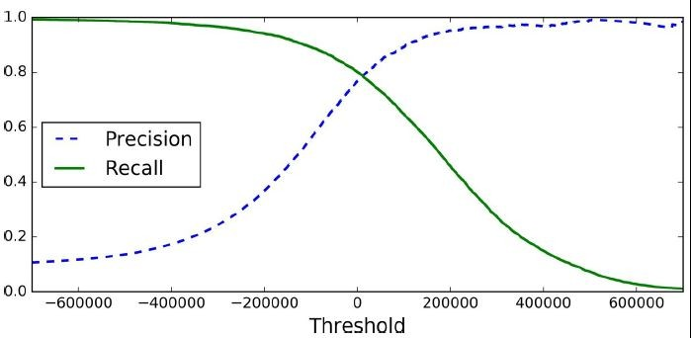
Precision / Recall Curve
Plotting precision/ recall curve using Scikit-Learn

Slide 98
Precision vs Recall Curve
Another way to select a good precision/recall tradeoff is to
plot precision directly against recall.
>>> def plot_precision_vs_recall(precisions, recalls): plt.figure(figsize=(18,7))
plt.plot(recalls[:-1], precisions[:-1], "b-", label="Precision") plt.xlabel("Recall")
plt.ylabel("Precision") plt.legend(loc="upper left") plt.ylim([0, 1])
>>> plot_precision_vs_recall(precisions, recalls)
>>> plt.show()
Run it on Notebook

Slide 99
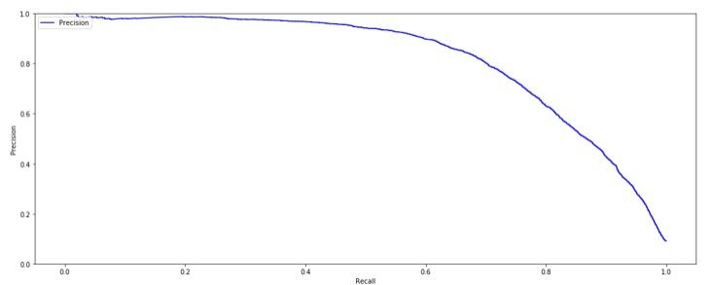
Precision vs Recall Curve
Another way to select a good precision/recall tradeoff is to
plot precision directly against recall directly.

Slide 100
Steps
Divide dataset into training and test samples
Train the classifier using training dataset
Test using sample data - some_digit
Performance metrics (Finalize the model)
Improve the model using error
analysis
Cross
Validation - Accuracy
Confusion Matrix
Precision
Recall
F1 Score
ROC Curve

Slide 101
Performance measures - ROC Curve
ROC Curve Similar to F1 score but uses a different metric
Uses True Positive Rate (TPR) = Recall = TP / (TP + FN)
False Positive Rate (FPR) = FP / (FP + TN)
= 1 - True Negative Rate (TNR)
TNR = TN / (FP + TN)
Receiver Operating Characteristics (ROC) plots: TPR versus FPR

Slide 102
Performance measures - ROC Curve
Making ROC Curve using sklearn
>>> | from | sklearn.metrics | import roc_curve
>>> | fpr, | tpr, thresholds | = roc_curve(y_train_5,
y_scores)
>>> def plot_roc_curve(fpr, tpr, label=None): plt.figure(figsize=(18,7))
plt.plot(fpr, tpr, linewidth=2, label=label) plt.plot([0, 1], [0, 1], 'k--')
plt.axis([0, 1, 0, 1]) plt.xlabel('False Positive Rate') plt.ylabel('True Positive Rate')
>>> plot_roc_curve(fpr, tpr)
>>> plt.show()
Run it on Notebook

Slide 103
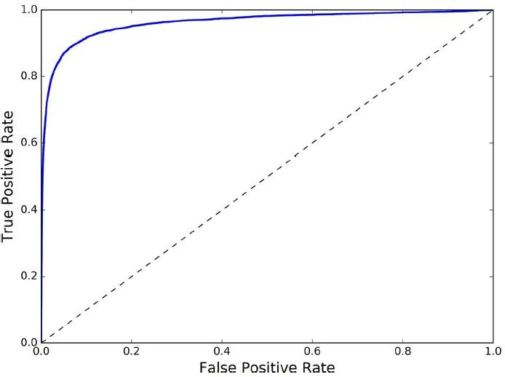
Performance measures - ROC Curve
Making ROC Curve using sklearn
Dotted line = purely random classifier

Slide 104
Performance measures - ROC Curve
Higher the recall (TPR True Positive Rate), higher is the FPR (False Positive Rate)
Dotted line = purely random classifier
Good classifier stays away from the dotted line towards top-left corner
A perfect classifier shall have a ROC Area Under the Curve (AUC) equal to 1 whereas a purely random classifier shall have ROC AUC = 0.5.

Slide 105
Performance measures - ROC Curve
Making ROC Curve using sklearn
# Scikit-Learn provides a function to compute the ROC AUC:
>>> from sklearn.metrics import roc_auc_score
>>> roc_auc_score(y_train_5, y_scores) 0.95505444284581809
Run it on Notebook

Slide 106
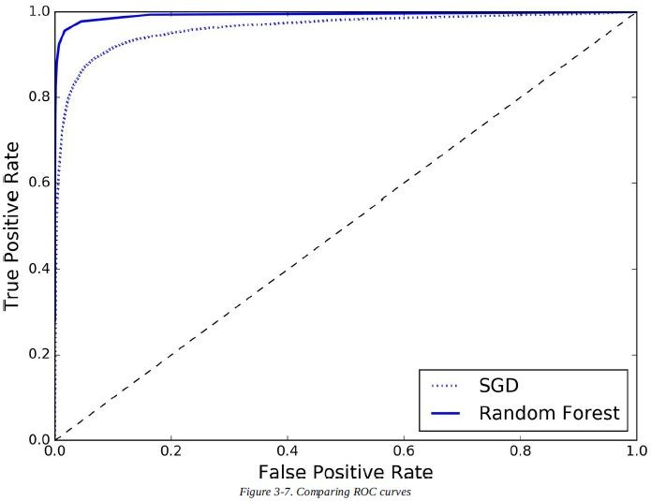
Performance measures - ROC Curve
RandomForestClassifier versus SGDClassifier comparison for digit 5 binary classifier

Slide 107
Performance measures - ROC Curve
RandomForestClassifier versus SGDClassifier comparison for digit 5 classifier
RandomForestClassifier uses predict_proba() instead of decision_function() for calculating the score of the classifier
>>> from sklearn.ensemble import RandomForestClassifier
>>> forest_clf = RandomForestClassifier(random_state=42)
>>> y_probas_forest = cross_val_predict(forest_clf, X_train, y_train_5, cv=3, method="predict_proba")
Run it on Notebook

Slide 108
Performance measures - ROC Curve
Plotting the ROC Curve for RandomForestClassifier
Treating the probability of the positive class as score
>>> y_scores_forest = y_probas_forest[:, 1]
>>> fpr_forest, tpr_forest, thresholds_forest = roc_curve(y_train_5,y_scores_forest)
>>> fig, ax = plt.subplots()
>>> ax.plot(fpr, tpr, "b:", label="SGD")
>>> ax.plot(fpr_forest, tpr_forest, linewidth=2, label="Random Forest")
>>> | ax.plot([0, | 1], | [0, |  | 1], | 'k--')
>>> | ax.legend(loc=4);
>>> | ax.set_title('ROC |  |  | curves');
Run it on Notebook

Slide 109
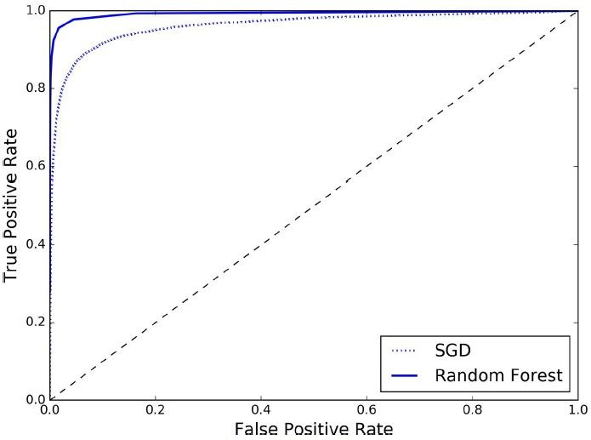
Performance measures - ROC Curve
ROC Curve for RandomForestClassifier versus SGDClassifier
RandomForestClassifier significantly better

Slide 110
Review - Binary Classification
Divide the dataset into training and test samples
Train the binary classifier
Choose the appropriate metric for the task (recall, precision, F1, ROC)
Select the precision/ recall tradeoff that fits the needs
Compare various models using ROC curves and ROC AUC curves

Slide 111
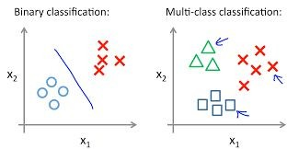
Multiclass Classification

Slide 112
Multi-class Classification
Binary classifiers distinguish between two classes
While multi-class classifiers (also called multinomial classifiers) can distinguish
Between more than two classes
Can distinguish between multiple classes
Eg. Random Forest classifiers , naive Bayes classifiers etc

Slide 113
Multiclass Classification
A Binary Classifier can be used for Multiclass Classification. There are basically two strategies for doing this.
One-versus-all (OvA) strategy also called one-versus-the-rest - for example,
For eg. to classify the digit images into 10 classes (from 0 to 9) one way is to train 10 binary classifiers, one for each digit (a 0-detector, a 1-detector, a 2-detector, and so on).
Then when you want to classify an image, select the class whose classifier outputs the highest score.

Slide 114
Multiclass Classification - OvA strategy
1 | 2 | 3 | 4 | 5
1 vs All classifier
1 | 2 | 3 | 4 | 5
2 vs All classifier
1 | 2 | 3 | 4 5
3 vs All classifier
1 | 2 | 3 | 4 | 5
4 vs All classifier
1 | 2 | 3 | 4 | 5
5 vs All classifier

Slide 115
Multi-class Classification
Doing multi-class classification using OvA Classifier
By default, scikit-learn SGDClassifier assumes OvA
# By default scikit learn SGDClassifier assumes OvA
>>> sgd_clf.fit(X_train, y_train)
# Under the hood it trained 10 classifiers
>>> sgd_clf.predict([some_digit]) array([ 5.])
Run it on Notebook

Slide 116
Multiclass Classification
1. One-versus-all (OvA) strategy
a. Under the hood, for the multiclass SGDClassifier example,
the classifier trains 10 binary classifiers and
selects the class with highest score

Slide 117
Multi-class Classification
Doing multi-class classification using OvA Classifier
10 classifier scores is obtained
Index of the maximum score is 5
>>> | some_digit_scores | = | sgd_clf.decision_function([some_digit])
>>> | some_digit_scores
array([[ | -86880.99526464, | -237672.82817877, | -166400.74040071,
 | -131594.15873554, | -191845.64360797, | 1206.46829305,
 | -330563.87557331, | -241281.56362563, | -308221.30939119,
-314369.41736179]])
# The highest score is indeed the one corresponding to class 5:
Run it on Notebook

Slide 118
Multiclass Classification
One-versus-one (OvO) strategy
This is another strategy in which we train a binary classifier for every pair of digits: one to distinguish 0s and 1s, another to distinguish 0s and 2s, another for 1s and 2s, and so on.
If there are N classes, you need to train N × (N – 1) / 2 classifiers.

Slide 119
Multiclass Classification
How many classifiers do we need to train in MNIST for OvO?

Slide 120
Multiclass Classification
How many classifiers do we need to train in MNIST for OvO?
10*9/2 = 45

Slide 121
Multiclass Classification - OvO Strategy
1 | 2 | 3 | 4 | 5
1 vs 2 classifier
1 | 2 | 3 | 4 | 5
1 vs 3 classifier
1 | 2 | 3 | 4 | 5
1 vs 4 classifier
1 | 2 | 3 | 4 | 5
1 vs 5 classifier
⇣
1 | 2 | 3 | 4 | 5
4 vs 5 classifier

Slide 122
Multi-class Classification
Doing multi-class classification using OvO Classifier
SGD uses OVA by default
Need to specifically mention OvO to do OvO classification
Number of estimators trained for MNIST dataset = 45
>>> from sklearn.multiclass import OneVsOneClassifier
>>> ovo_clf = OneVsOneClassifier(SGDClassifier(random_state=42, max_iter=20))
>>> ovo_clf.fit(X_train, y_train)
>>> ovo_clf.predict([some_digit]) array([ 5.])
>>> len(ovo_clf.estimators_) 45
Run it on Notebook

Slide 123
Switch to Notebook

Slide 124
Steps
Divide dataset into training and test samples
Train the classifier using training dataset
Test using sample data - some_digit
Performance metrics (Finalize the model)
Improve the model using error analysis

Slide 125
Error Analysis
Once the model (classifier) is identified, it can be improved by analyzing the types of errors it makes
For the previous multiclass classification example of classifying images of digits into digit labels, it can be done by observing the confusion matrix and plotting it on the graph

Slide 126
Confusion Matrix - Recap
For ‘5’ and ‘Not 5’ classifier
True Negative (TN)
False Positive (FP)
Confusion Matrix
Prediction
Not 5
5
Total
Not 5
53272
1307
54579
Actual
5
1077
4344
5421
False Negative (FN)
True Positive (TP)
Total
54349
5651
60000

Slide 127
Multi-class Classification - Review
Identifying to which label something belongs to

Slide 128
Confusion Matrix - Multiclass
Confusion matrix for Multiclass classifier
Number of instances actually 0 and correctly predicted as 0
Actual | Prediction
 |  | 0 | 1 | 2 | 3 | ... | 9 | Total
 | 0 | 5725 | .. | ... | .. | .. | 4
 | 1 | .. | .. | .. | .. | .. | ..
 | 2 Numb | .. er of ins | .. tances ac | .. tually 0 | .. and incor | .. rectly pr | .. edicted as | 9
 | ... | .. | .. | .. | .. | .. | ..
 | 9 | 43 | .. | .. | .. | .. | 5240
 | Total |  |  |  |  |  |  | 60000

Slide 129
Error Analysis
Calculating confusion matrix for multiclass using Scikit-Learn
>>> y_train_pred = cross_val_predict(sgd_clf, X_train_scaled, y_train, cv=3)
>>> | conf_mx | = | confusion_matrix(y_train, | y_train_pred)
>>> | conf_mx
array([[5730, | 2, | 23, | 8, | 11, | 43, | 51, | 8, | 43, | 4],
[ 1, | 6472, | 46, | 25, | 6, | 45, | 5, | 12, | 119, | 11],
[ 47, | 35, | 5351, | 101, | 85, | 24, | 89, | 53, | 160, | 13],
[ 47, | 39, | 136, | 5359, | 1, | 223, | 34, | 54, | 142, | 96],
[ 14, | 27, | 40, | 11, | 5356, | 8, | 54, | 33, | 94, | 205],
[ 65, | 40, | 36, | 186, | 68, | 4610, | 102, | 32, | 195, | 87],
[ 30, | 24, | 45, | 2, | 45, | 98, | 5614, | 5, | 54, | 1],
[ 25, | 17, | 74, | 29, | 54, | 13, | 6, | 5798, | 19, | 230],
[ 45, | 139, | 68, | 154, | 10, | 150, | 57, | 25, | 5080, | 123],
[ 39, | 32, | 30, | 86, | 167, | 34, | 2, | 203, | 88, | 5268]],
dtype=int64)
Run
it
on
Notebook

Slide 130
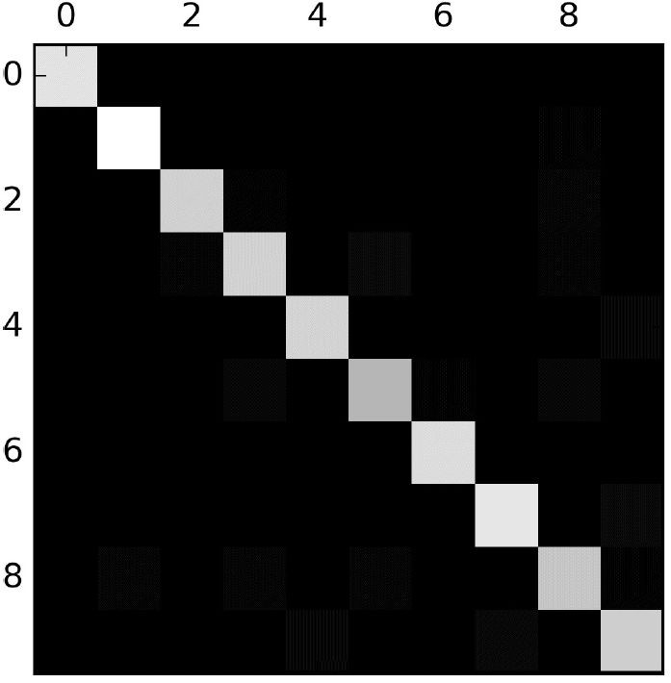
Error Analysis
Plotting confusion matrix for multiclass using Scikit-Learn
>>> plt.matshow(conf_mx, cmap=plt.cm.gray)
>>> plt.show()
Run
it
on
Notebook

Slide 131
Error Analysis
Observations:
???

Slide 132

Error Analysis
Observations:
Looks fairly good since most images are on the diagonal
5s looks darker than other digits, why?
Fewer 5s in the dataset
Classifier does not perform well on 5s
Both

Slide 133

Error Analysis
Observations:
Looks fairly good since most images are on the diagonal
5s looks darker than other digits, why?
Fewer 5s in the dataset
Classifier does not perform well on 5s
Both

Slide 134
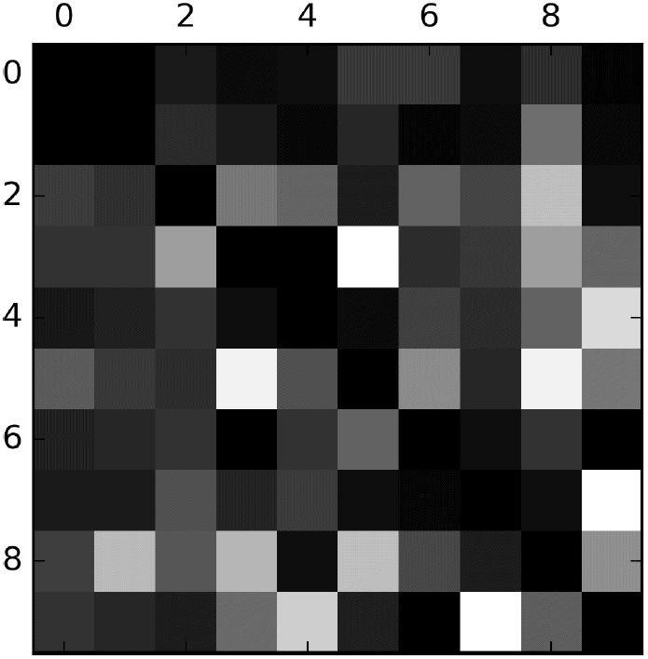
Error Analysis
Lets take a closer Look:
# Highlight the errors by normalizing
>>> row_sums = conf_mx.sum(axis=1, keepdims=True)
>>> norm_conf_mx = conf_mx / row_sums
# Remove the correct predictions
>>> np.fill_diagonal(norm_conf_mx, 0)
>>> plt.matshow(norm_conf_mx, cmap=plt.cm.gray)
>>> plt.show()
Run it on Notebook

Slide 135
Error Analysis
Observations:
8 and 9 columns are bright: many digits misclassified as 8 and 9
8 and 9 rows are bright:
many 8 and 9 misclassified as other digits
(3,5) and (5,3) are abnormally bright: confusion between 3 and 5
Actual
Prediction

Slide 136
Error Analysis
Possible solutions:
Gather more training data for 8s and 9s
Engineer new feature that would help the classifier like number of loops in the image of the digit
Preprocess images
using Scikit-Image, Pillow, or OpenCV ...
to make certain features stand out more
Analyzing individual errors
Observations:
8 and 9 columns are bright: many digits misclassified as 8 and 9
8 and 9 rows are bright: many
8 and 9 misclassified as other digits
(3,5) and (5,3) are abnormally bright: confusion between 3 and 5

Slide 137
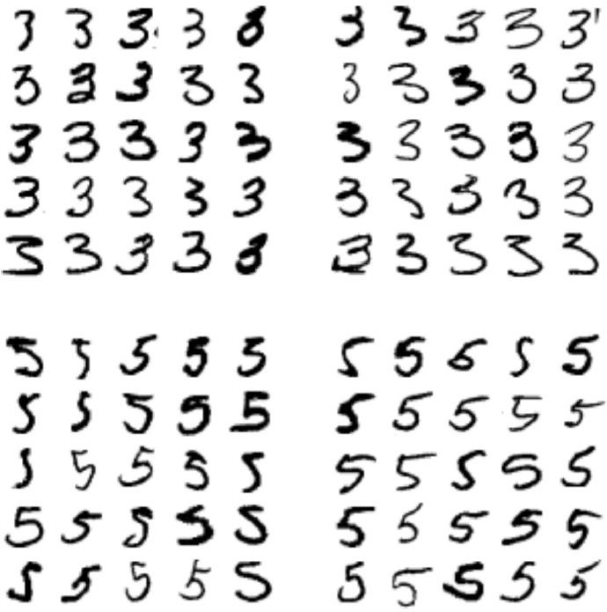
Error Analysis
Analyzing individual errors (plotting 3s and 5s)
Actual 3,
Predicted 3
Actual 3,
Predicted 5
Actual 5,
Predicted 3
Actual 5,
Predicted 5

Slide 138


Error Analysis
Observation:
Some digits are written badly while most are errors in classification (between 3s and 5s).
SGDClassifier assigns a weight per class to each pixel and calculate the total score for a particular class
Since 3s and 5s differ by a few pixels, the classifier is easily confused - Main difference between 3 and 5 is the position of the straight line

Slide 139
Error Analysis - Possible Solution
Classifier is quite sensitive to image shifting and rotation
Solution: Preprocess the image to ensure that they are well-centered and not rotated

Slide 140
Review till now?
Divide dataset into training and test samples
Train the classifier using training dataset
Test using sample data - some_digit
Performance metrics (Finalize the model)
Improve the model using error
analysis
Cross
Validation - Accuracy
Confusion Matrix
Precision
Recall
F1 Score
ROC Curve

Slide 141
What do we do next?
Completed:
Binary Classification
Multi-class Classification
Next:
Multi-label Classification
Multi-output Classification

Slide 142







Multilabel Classification
Explanation by example 1
Is Bob there in the image? Is Alice there in the image?
Is Charlie there in the image?
Multi-labels
So there are two classifications in the same image
True
False True
Classifier

Slide 143
Multilabel Classification
Explanation by example 2
Is it large? [7 or 8 or 9]
Is it odd? [1or 3 or 5 or 7 or 9]
So there are two classifications in the same image
False (Small)
Classifier
True (Odd)

Slide 144
Multilabel Classification - Example
Classification of image into whether [large, odd], how do we do it?
Step 0: Fetch the data set (already done previously)
Divide dataset into training and test samples
Train the classifier using training dataset
Test using sample data - some_digit
Performance metrics (Finalize the model)
Improve the multi-label classification
model using error analysis
>>> from sklearn.datasets import fetch_mldata
>>> mnist = fetch_mldata('MNIST original')
>>> X, y = mnist["data"], mnist["target"]
>>> some_digit = X[36000]

Slide 145
Multilabel Classification - Example
Step 1: Divide the dataset into training and test samples (new labels according to the requirement)
Shuffling of dataset already done previously
>>> y_train_large = (y_train >= 7)
>>> y_train_odd = (y_train % 2 == 1)
>>> y_multilabel = np.c_[y_train_large, y_train_odd] to concatenate the two arrays element wise
# np.c_ is used
Run it on Notebook

Slide 146
Multilabel Classification
Step 2: Train the classifier
KNeighbours Classifier supports multi-label, classification
Divide dataset into training and test samples
Train the classifier using training dataset
Test using sample data - some_digit
Performance metrics (Finalize the model)
Improve the multi-label classification
model using error analysis
>>> from sklearn.neighbors import KNeighborsClassifier
>>> knn_clf = KNeighborsClassifier()
>>> knn_clf.fit(X_train, y_multilabel)
Run it on Notebook

Slide 147
Multilabel Classification
Step 3: Test the dataset
Divide dataset into training and test samples
Train the classifier using training dataset
Test using sample data - some_digit
Performance metrics (Finalize the model)
Improve the multi-label classification
model using error analysis
>>> knn_clf.predict([some_digit]) array([[False, True]], dtype=bool)
Digit 5 is not large (i.e. it not 7 or 8 or 9) but is odd

Slide 148
Multilabel Classification
Classification of image into whether [large, odd], how do we do it?
Divide dataset into training and test samples
Train the classifier using training dataset
Test using sample data - some_digit
Performance metrics (Finalize the model)
Improve the multi-label classification
model using error analysis
>>> y_train_knn_pred = cross_val_predict(knn_clf, X_train, y_train, cv=3)
>>> f1_score(y_train, y_train_knn_pred, average="macro") 0.96845540180280221
Run it on Notebook

Slide 149
Multi-Output Classification
It is simply a generalization of multilabel classification where each label can be multiclass (i.e., it can have more than two possible values).
Multi-output classification example:
Removing noise from images
We'll build a system that removes noise from images. It will take as input a noisy digit image, and it will output a clean digit image, represented as an array of pixel intensities, just like the MNIST images.

Slide 150
Multi-Output Classification
Notice that the classifier’s output is
Multilabel (one label per pixel) - so 784 labels
Multiclass: And each label can have multiple values (pixel intensity ranges from 0 to 255) - 256 classes.
It is thus an example of a Multioutput classification system.

Slide 151


Multi-Output Classification
144 One label | 200 One label | 64 One label
94 One label | 105 One label | 74 One label
149 One label | 200 One label | 123 One label
28 columns
0 to 255 values possible
28 rows

Slide 152
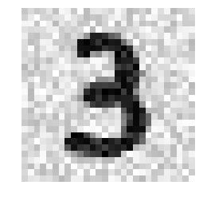

Multi-Output Classification
Our system will remove noise from images. Input will be a noisy digit image, and it will output a clean digit image, represented as an array of pixel intensities, just like the MNIST images.
Input Image
Output Image

Slide 153
Multi-Output Classification
Demonstrating multi-output classifier: digit image noise removal
Adding noise to the training set
>>> import numpy.random as rnd
>>> noise_train = rnd.randint(0, 100, (len(X_train), 784))
>>> X_train_mod = X_train + noise_train
Run it on Notebook

Slide 154
Multi-Output Classification
Adding noise to the test set
>>> noise_test = rnd.randint(0, 100, (len(X_test), 784))
>>> X_test_mod = X_test + noise_test
Run it on Notebook

Slide 155
Multi-Output Classification
Setting clean image as the label (y_train and y_test)
>>> y_train_mod = X_train
>>> y_test_mod = X_test
Run it on Notebook

Slide 156
Multi-Output Classification
Let us view the noisy image
>>> def plot_digit(array):
array_image = array.reshape(28, 28) plt.imshow(array_image, cmap = matplotlib.cm.binary,
interpolation="nearest") plt.axis("off") plt.show()
>>> plot_digit(X_test_mod[4000])
Run it on Notebook

Slide 157
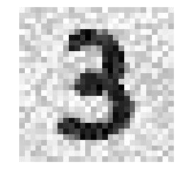
Multi-Output Classification
Let us view the noisy image
Run it on Notebook

Slide 158
Multi-Output Classification
Let us clean the image using the Classifier
>>> knn_clf.fit(X_train_mod, y_train_mod)
>>> clean_digit = knn_clf.predict([X_test_mod[4000]])
Run it on Notebook

Slide 159

Multi-Output Classification
Plotting the clean image
>>> plot_digit(clean_digit)
Run it on Notebook

Slide 160
Review till now?
Divide dataset into training and test samples
Train the classifier using training dataset
Test using sample data - some_digit
Performance metrics (Finalize the model)
Improve the multi-class classification
model using error analysis
Binary
Multiclass Classification
Multilabel Multi-output
Classification
Cross
Validation - Accuracy
Confusion Matrix
Precision
Recall
F1 Score
ROC Curve

Slide 161
Stochastic Gradient Descent (SGD) Classifier
What is hinge loss?

Slide 162
Stochastic Gradient Descent (SGD) Classifier
What is hinge loss?
For the training data, there are two labels:
y_true = 1 or
y_true = -1
(1,1) Class: 1
(0,0) Class: -1

Slide 163
Stochastic Gradient Descent (SGD) Classifier
Prediction_score denotes how far is the training set from the classifier
+ve: on the positive side
-ve: on the negative side
| prediction_score | > 1
(1,1) Class: 1
prediction_score < -1
Prediction_score > 1
(0,0) Class: -1

Slide 164
Stochastic Gradient Descent (SGD) Classifier
y_true * prediction_score becomes
negative and less than -1 for incorrect prediction
Positive and greater than 1 for correct prediction
(1,1) Class: 1
y_true * prediction_score > 1
y_true * prediction_score
1
(0,0) Class: -1

Slide 165
Stochastic Gradient Descent (SGD) Classifier
y_true * prediction_score becomes
negative and less than -1 for incorrect prediction
positive and greater than 1 for correct prediction
(1,1) Class: 1
y_true * prediction_score > 1
y_true * prediction_score
1
(0,0) Class: -1

Slide 166
Stochastic Gradient Descent (SGD) Classifier
1 - y_true * prediction_score becomes
negative and less than -1 for correct prediction
positive and greater than 1 for incorrect prediction
(1,1) Class: 1
1 - y_true * prediction_score < 0
1 - y_true * prediction_score < 0
(0,0) Class: -1

Slide 167
Stochastic Gradient Descent (SGD) Classifier
Hinge Loss = max(0,1 - y_true * prediction_score) becomes
0 and less than -1 for correct prediction
positive and greater than 1 for incorrect prediction
(1,1) Class: 1
Hinge loss = 0
Hinge loss = 0
(0,0) Class: -1

Slide 168
Stochastic Gradient Descent (SGD) Classifier
Hinge Loss = max(0,1 - y_true * prediction_score) becomes
0 and less than -1 for correct prediction
positive and greater than 1 for incorrect prediction
Minimize the hinge loss
(1,1) Class: 1
Hinge loss = 0
Hinge loss = 0
(0,0) Class: -1

Slide 169
Performance measure - Cross Validation
Cross Validation using StratifiedKFold of scikit-learn involves:
Custom code to split the training dataset into K folds
Evaluate the performance on the test data and print the performance
Divide dataset
into training and test data
Train using SGD classifier
Test using test dataset

Slide 170
Performance measures - Never5Classifier
‘5’ and ‘Not 5’ classifier
Cross_val_score: As in the previous lecture, use cross_val_score to perform cross validation
>>> never_5_clf = Never5Classifier()
>>> cross_val_score(never_5_clf, X_train, y_train_5, cv=3, scoring="accuracy") array([ 0.909 , 0.90715, 0.9128 ])
from sklearn.base import BaseEstimator class Never5Classifier(BaseEstimator): def fit(self, X, y=None):
pass
def predict(self, X):
return np.zeros((len(X), 1), dtype=bool)
Divide dataset
into training and test data
Train using SGD classifier
Test using test dataset

Slide 171
Stochastic Gradient Descent (SGD) Classifier
The class SGDClassifier implements
a plain stochastic gradient descent learning routine
supports different loss functions and
Loss function defines the type of classifier: hinge (linear), etc.
Other options to be discussed later are: ‘log’, ‘squared_hinge’, ‘perceptron’
Loss function: hinge

Slide 172

Stochastic Gradient Descent (SGD) Classifier
The class SGDClassifier implements
a plain stochastic gradient descent learning routine
supports different loss functions and
penalties for classification
L2: least squares
L1: mod of the error
Penalties: L2

Slide 173

Stochastic Gradient Descent (SGD) Classifier
Start with a certain weight vector [w1, w2]
And a certain learning factor (eta)
Iterate and update the weight vector using the training dataset until further change is minimum
Loss function: hinge Penalties: L2
Learning rate: eta

Slide 174
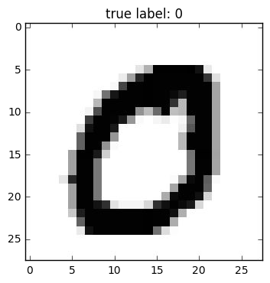
Dataset
MNIST dataset
Set of 70,000 small handwritten images of digits
Labelled by the digits it represents
Sample images Dataset image

Slide 175

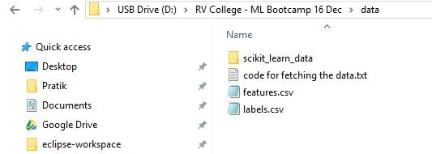

Setting Up!
Copy ‘scikit_learn_data’ from the usb to the home folder.
Local Home Folder
USB Drive

Slide 176

Setting Up!
Start Anaconda Launcher - Open Jupyter notebok

Slide 177
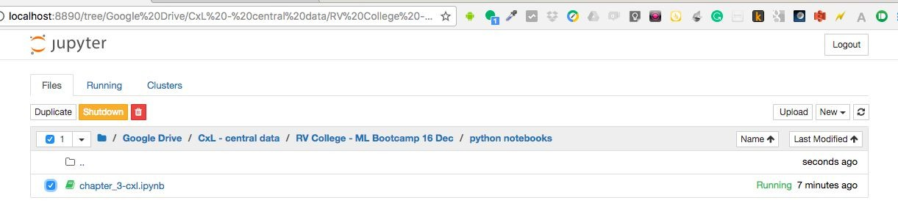
Setting Up!
Navigate to the folder in which you copied the whole USB

Slide 178
Multi-class Classification
Doing multi-class classification using OvO Classifier
Random Forest classifier directly does multi-class classification
No OvO or OvA strategy
Result: probability of the digit being 5 is the highest: 0.8
>>> forest_clf.fit(X_train, y_train)
>>> forest_clf.predict([some_digit])
>>> forest_clf.predict_proba([some_digit]) array([[ 0.1, 0. , 0. , 0.1, 0. , 0.8,
0. , 0. , 0. , 0. ]])
Run it on Notebook

Slide 179
Precision / Recall Curve
Q. How to decide the best threshold? What is the best threshold for below?

Slide 180
Precision / Recall Curve
Q. How to decide the best threshold? What is the best threshold for below?
Ans. Depends on the requirement of the project.

